Slide 1
VIVA
Andrew McGouran (T7068437)
Camron Ali (S6301166)
Matthew Marr (T7037477)
Jason Flower (T7047098)

Slide 2
Scenario
Tram-scape require a thin layer middleware software to allow different staff members to communicate. They also require the system to allow for messages from the on bored semi-intelligent AI of the tram to communicate with staff and certain systems through the middleware. However, Tram-scape have asked that the middleware is able to be used within many systems and is a generic thin middleware system.

Slide 3
Achievements
A system that allows staff (or any agent/user) to communicate between them and have remote access from the system. It also allows for a agent to be a tram and send diagnostic data to a specific agent.
Furthermore, it is design so that it could be used as a thin layer middleware software for any system that requires messages being sent between Agents.

Slide 4
Features
Agent to Agent communication through a portal.
Remote connection, no direct access to portal required just IP address and port number.
Intelligent routing to find the Agent the message is intended for.
Allows a message to be sent to all Agents from one Agent.
Allows different message types and adjusts the Agents GUI accordingly

Slide 5
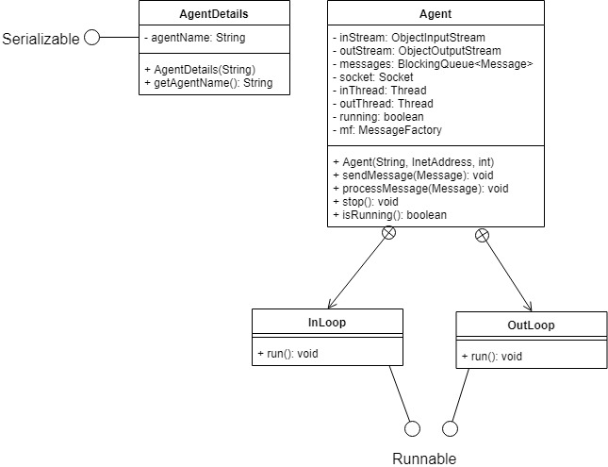
Agent Class Diagram

Slide 6
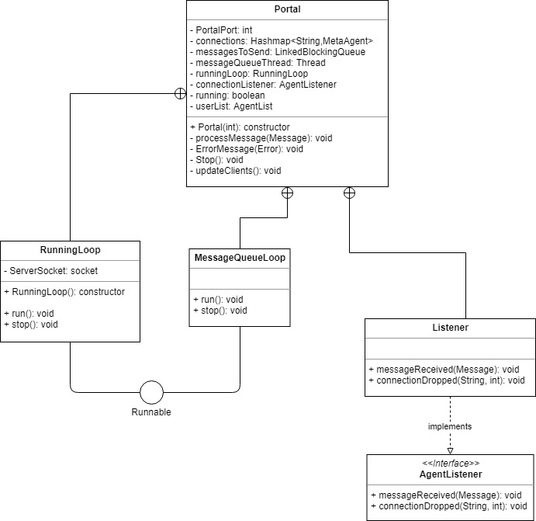
Portal Class Diagram

Slide 7
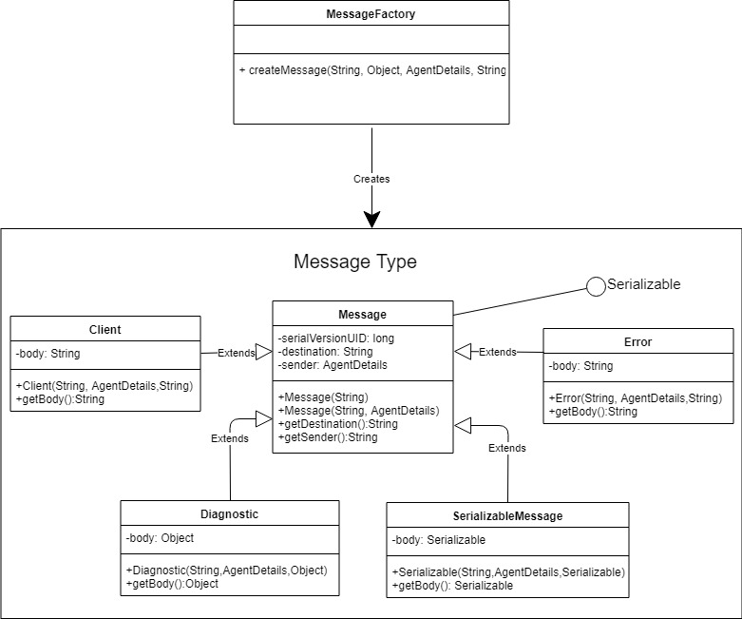
Message Class Diagram

Slide 8
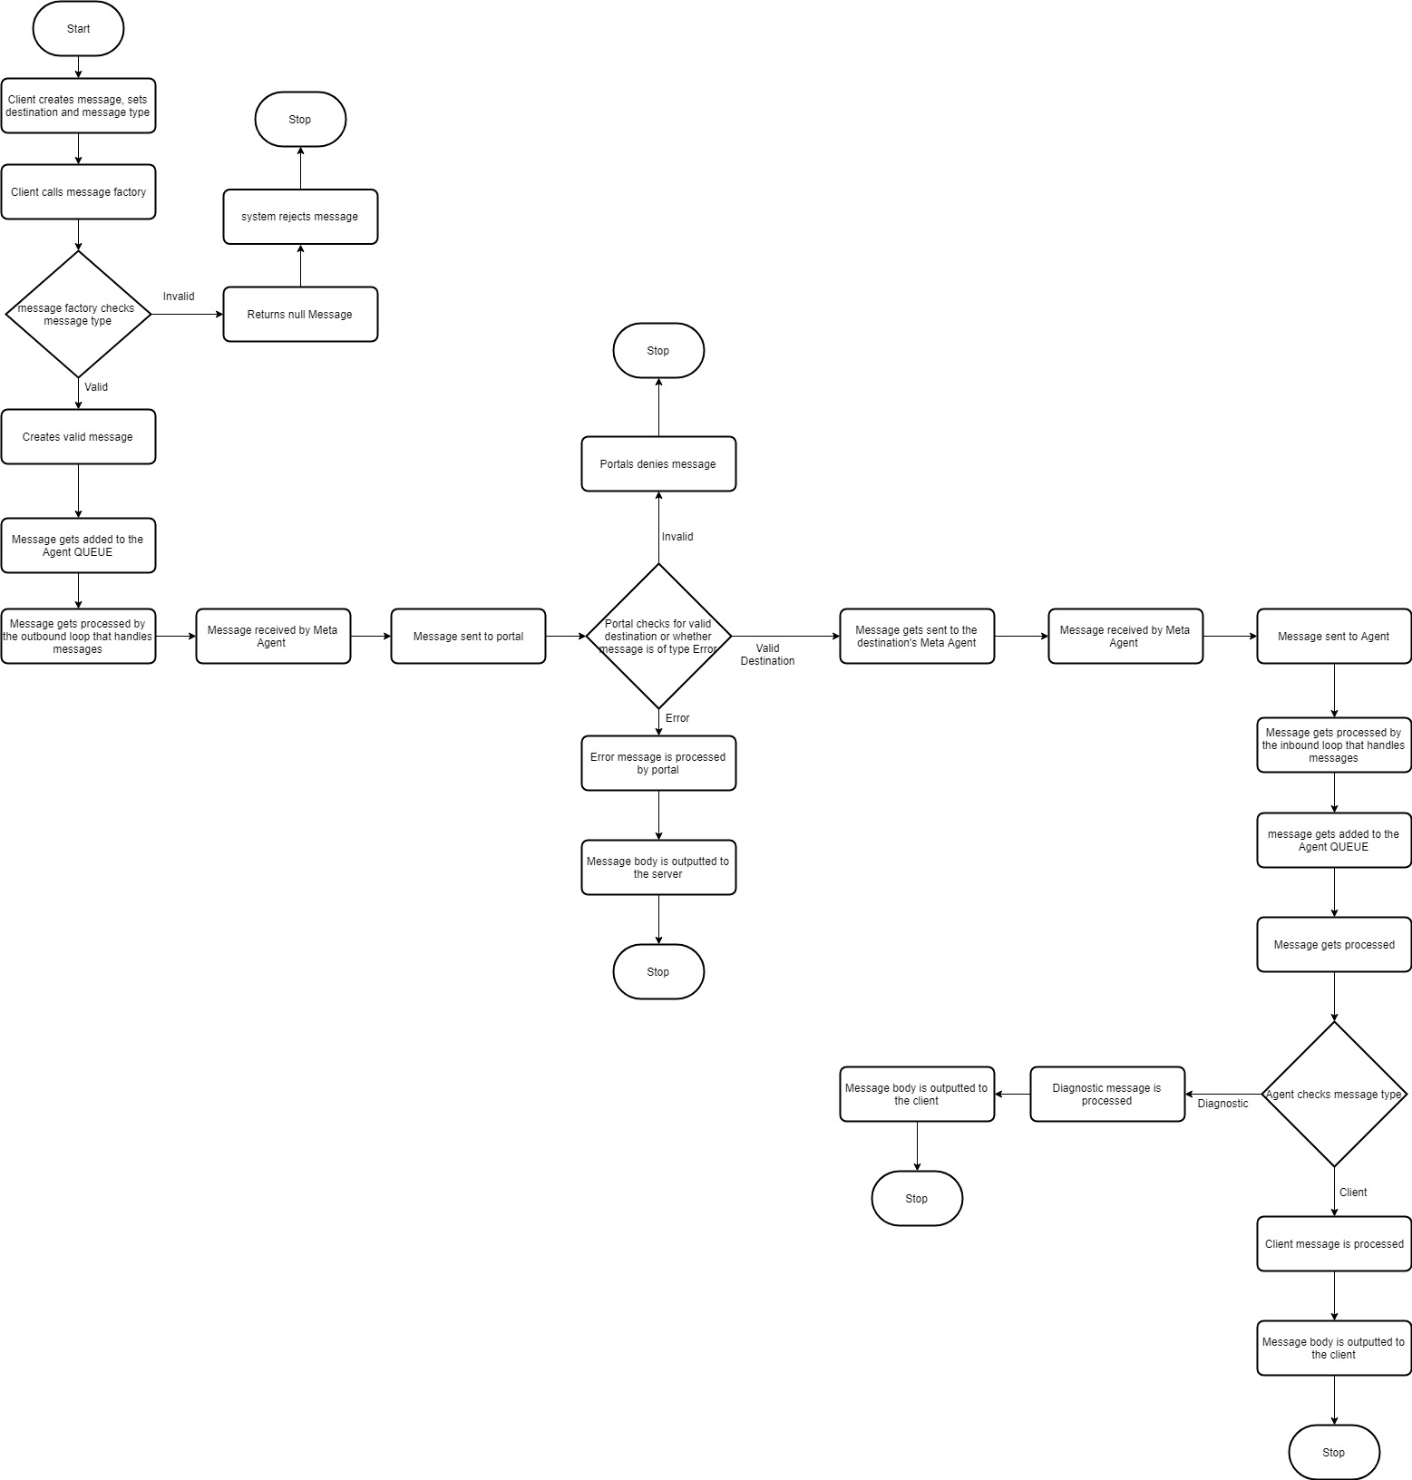
Message Flow Diagram

Slide 9
Tests
Send message between two clients
Send messages using all different message types
Establish 1905 client connections with them sending to all
Create a large number of agents and send to each individual agents

Slide 10
Limitations
Processing capabilities become slow once you get into the region of 100’s of agents joining together
The system is only designed to send messages and is unable to send anything else
Not setup for the open-closed principle
Ideally we should of implemented key features as interfaces such as the message processing part of the middleware, so the program can be scaled more effectively once they’re more types of messages being handled by the system.

Slide 11
Comprises
We comprised on the design of the client list as if we designed it to automatically update the GUI every time the agent looked for another agent because it put too much demand on the portal and dramatically slowed down its capabilities. The comprised we settled for as a future addition is to use the prebuilt setup to be a request from the agent when they want to view who is currently connected.

Slide 12
Features to implement
Portal to portal
Extend the processing speed capabilities
Updated GUI
Allow the user to directly know who is connected via a client list request
Add a response message area so that the message sent to the agent is viewed through the GUI
Setup up the system so that it abides by the open-closed principle

